Slide 1


Intro to Github Webinar for Students
Presentation by: Jack Duncan (NISR Data Science)

Slide 2
Housekeeping
Webinar will run until 11am
Questions will be answered at the end
Slides will be shared afterwards in the description of the uploaded video

Slide 3
Contents
Introduction to version control
Why use version control?
What is git/GitHub and why do we use it?
Linking your computer to your GitHub account
Git from the command line
Git from GitHub desktop
General tips
Hackathon information
Future webinars

Slide 4
Introduction to version control
Version Control is a system that records changes to a file or set of files over time. This allows you to recall specific versions later.
It enables collaboration, tracks history, and helps manage project evolution. Commonly used tools include git, svn, and mercurial.
Todays discussion will revolve around git, and GitHub as a version control system

Slide 5
Why use version control?
Enables multiple people to work on the same project simultaneously without conflict
Keeps a history of the project's progress, allowing easy reversion
Mistakes will happen; version control lets you revert to a previous point effortlessly
Provides a clear overview of project development, including what changes were made, by whom, and when

Slide 6
What is Git/Github?
Git is a version control system
A way to manage files and directories
Track changes over time
Recall previous versions
GitHub is program built on top of git to store your files online in a way that can be easily shared and worked on
GitHub primarily works using ‘repositories’ which are essentially online folders that you can upload to and download from

Slide 7
Why do we use it?
GitHub is one of the mostly widely used software tools in data science
This is for three main reasons:
Safety - to have a secure, online backed up version of our code
Transparency - to easily share code and analysis with others, including team members and stakeholders
Community - to enable collaboration on projects both within your team and with the broader GitHub community

Slide 8
Linking your computer to Github
Prerequisites:
Git installed on your computer
Registered Github account
Open command line – and enter username and email for Github account using commands below:
git config --global user.name ‘John Doe’
git config --global user.email ‘JohnDoe@email.com’

Slide 9
Basic git functions on the command line
Important git commands to understand:
Clone
Status
Add
Commit
Push
Pull
Notes:
Now we have a repository to work from, we need to learn how to use it locally and then store those changes online. For working with git at this stage there will be 5 commands that are primarily used. It’s helpful to see the git workflow before going into what these commands are and how we use them.

Slide 10
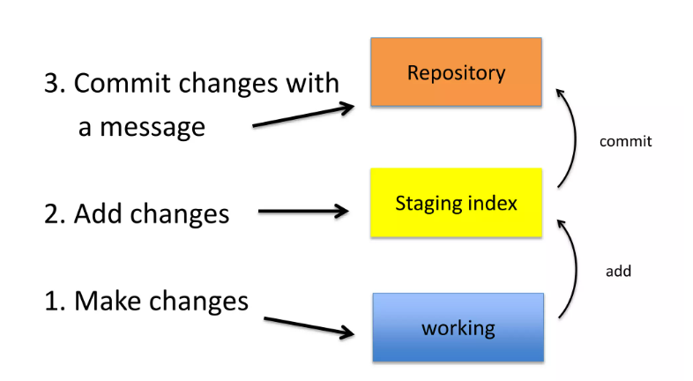
Basic git functions on the command line
Notes:
This will be our basic workflow within github. At the top is the repository, where all the files are stored. When we make changes it’s in the working area, we then add these changes to the staging index before committing the changes back to the repository. Once all the changes are finished we then push them to the repository to make the changes final.

Slide 11
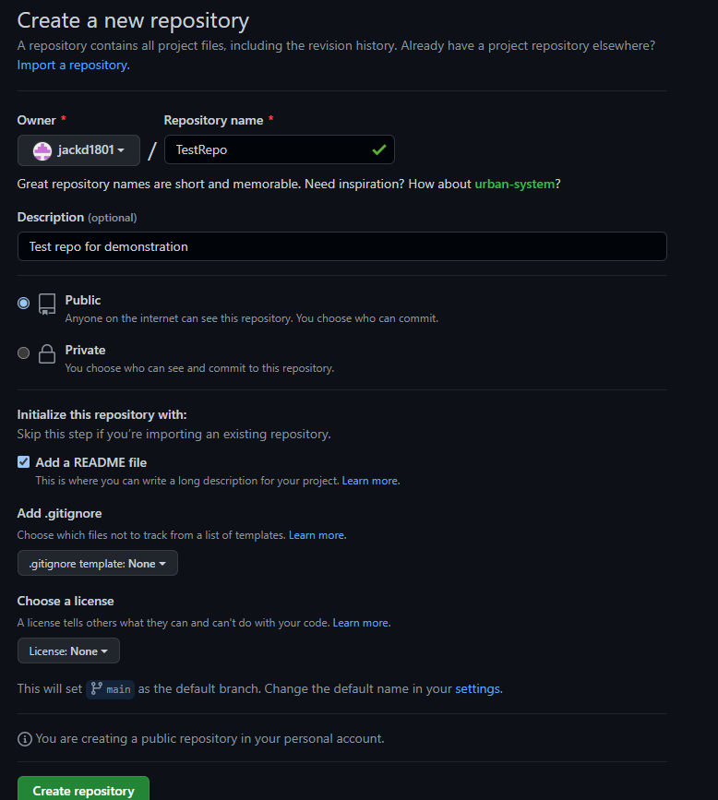
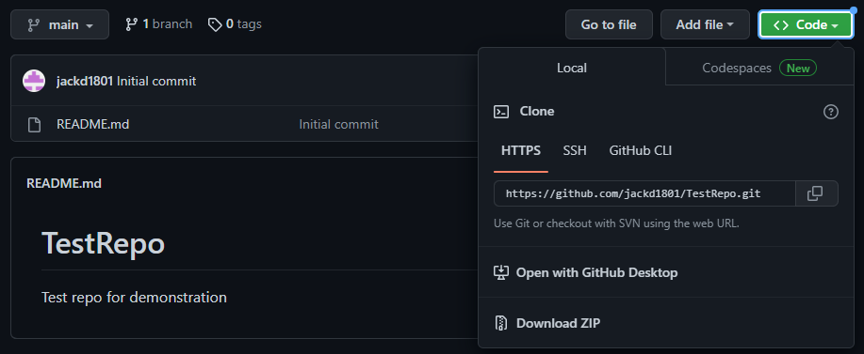
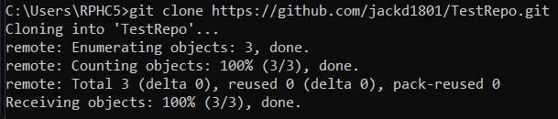
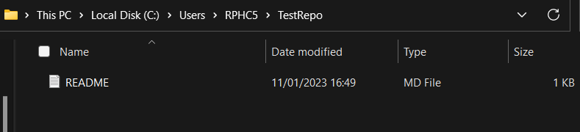
Basic git – clone
2
3
1
4
Notes:
The first thing we’re going to do is clone a repository. The easiest way to do this is to first create a new repository within github. For this test repository we will add a readme file and have no gitignore. Adding the readme ensures that there is something within your new repository to clone. Github only registers folders if they have something within them. Additionally, depending on the project, consider your privacy settings. When working on something you want to share publicly or is not sensitive, public is fine. When working for a company or on university projects private may be a more sensible option. Private repositories can be shared with people later.
Now you should be at the landing page for your new repository in github – click on the green code button and then copy the url for your new repository.
Go to the command line and type ‘git clone’ and paste the url to your repository, then press enter.
You should be able to go into your local drive and find the repository with the contained README file.

Slide 12
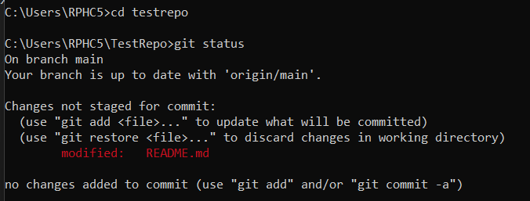
Basic git - status
Open the README file from your file explorer using notepad
Add a line saying ‘Test text from notepad’
Open your terminal, set the working directory to your repository using cd TestRepo
Check the status using git status
Notes:
Git status lets you check on the overall status of your repository – it’ll show you what stage different files are at in the git process. Here we can see that we have changes in the working area that haven’t been staged yet.

Slide 13
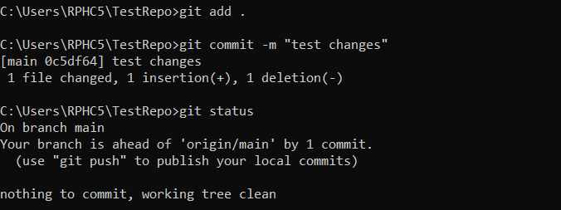
Basic git – add and commit
Add your changes to the staging area using git add .
Commit the changes using git commit –m “test changes”
Check the status using git status
Notes:
Now we’re going to add those changes to the staging area, ready to be committed.
The dot tells git to add all the changes you have made, if you don’t want to add all your changes, you can specify which files you want moved to the staging area by typing the name of that file in place of the .

Slide 14
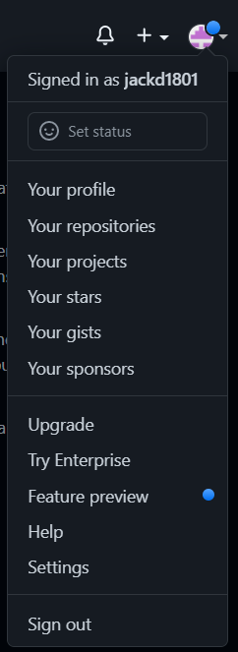
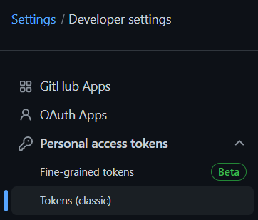
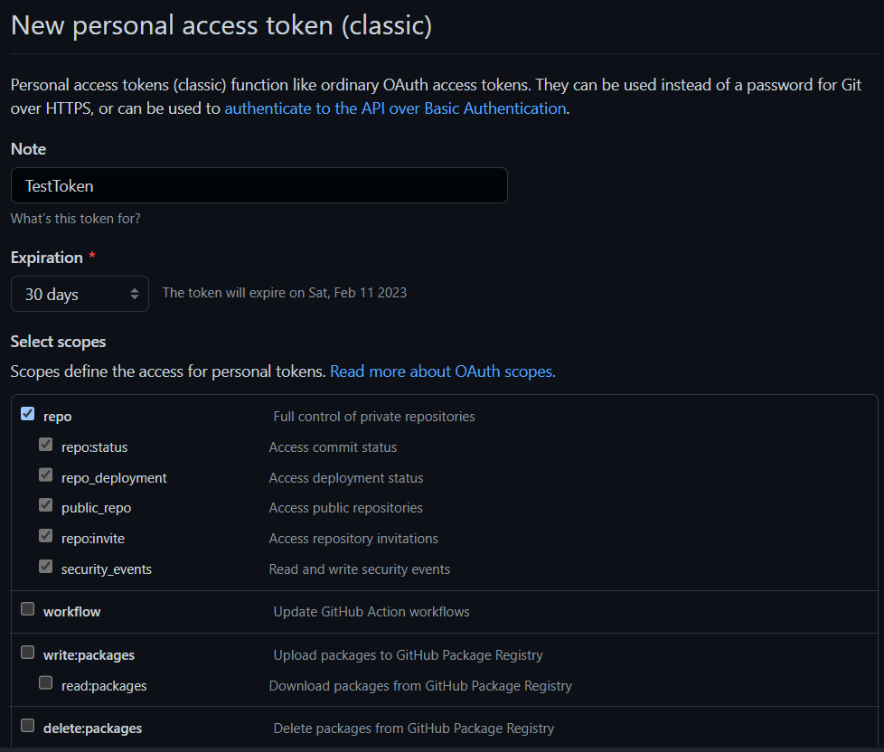
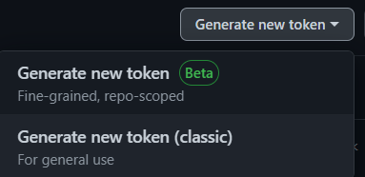
Basic git - push
1
2
4
3
5
Notes:
Click on the icon for your profile in the top right of github – then click on settings
Go to developer settings at the bottom of the bar on the left hand side on your settings page and click personal access tokens, then tokens (classic)
Click generate new token (classic)
Name your token and check the repo box – do not check any others
Generate the token

Slide 15
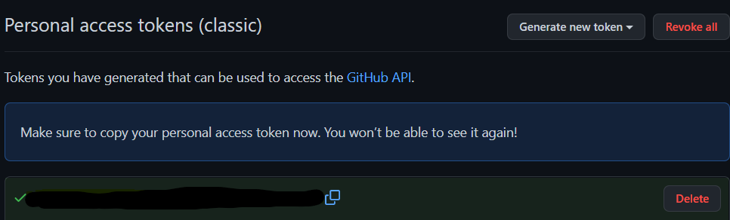
Basic git - push
Notes:
Your personal access token will then show – you can only see this once so copy and save it somewhere secure i.e. in a word document or a notepad file

Slide 16
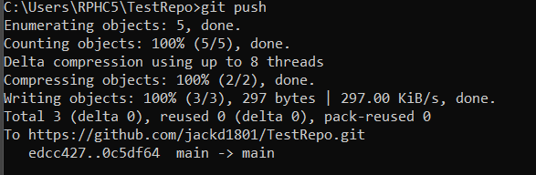
Basic git - push
Push your change using git push
You will be prompted to sign into github – use your personal access token to give access and the push will then complete

Slide 17

Basic git - pull
Git pull opposite of git push
Pull changes from the online repository to your local repository
Use command git pull
Notes:
Git pull is essentially the opposite of git push. Here we pull down changes from the online repository to our local machine. This is used when we have worked on a project using another computer or are working with others and they have made updates. Always pull when you open a repository to make sure you are using the latest version.

Slide 18
Using Github desktop
While it is good to use command line to understand how git works, it isn’t the most intuitive
Can also use github desktop to manage changes
Some Interactive Development Environments (IDEs) also have built in GitHub integration

Slide 19
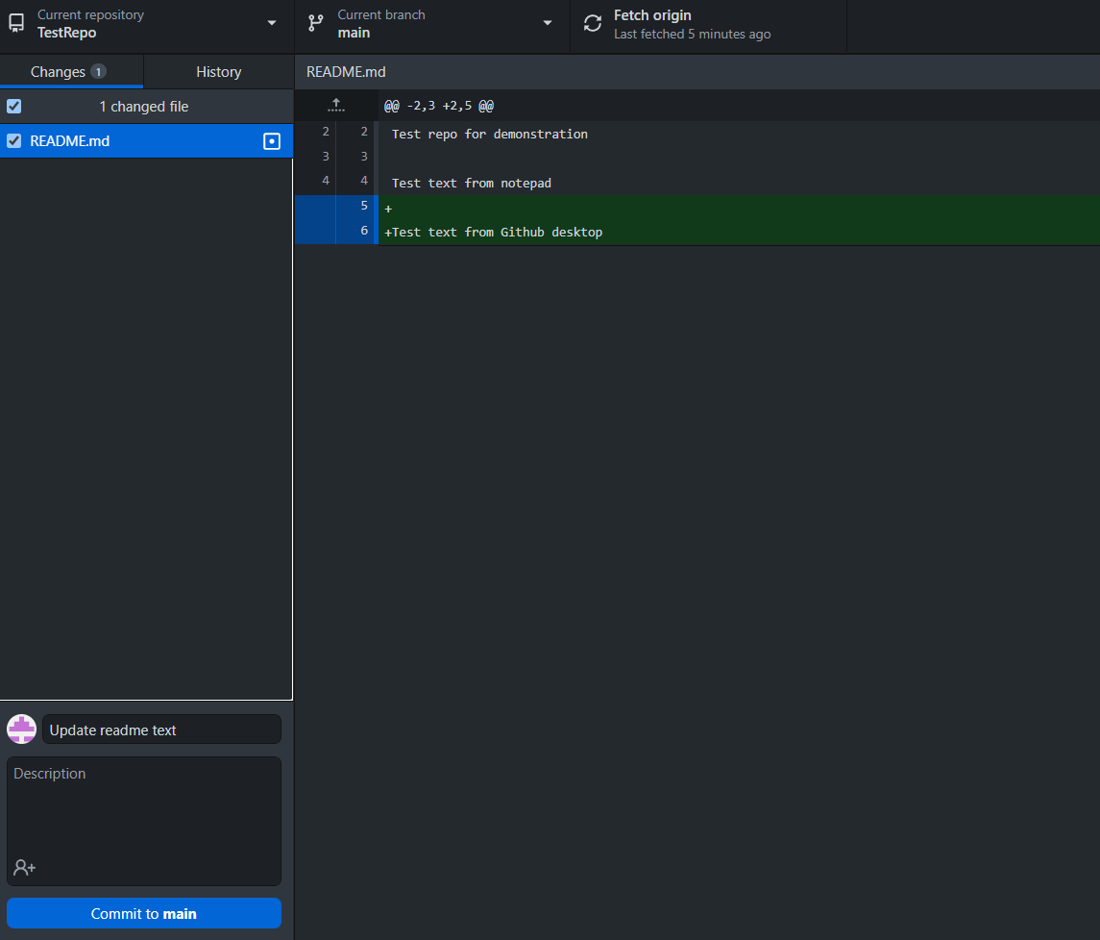
Github desktop – status, add & commit
Notes:
Make a change to your local readme file saying ‘test text from github desktop’ and save
Open the repository in github desktop to see the changes you have made
Look at the changes in the github desktop text window to see that it has gone through
Write a title for your commit
Press commit to main

Slide 20
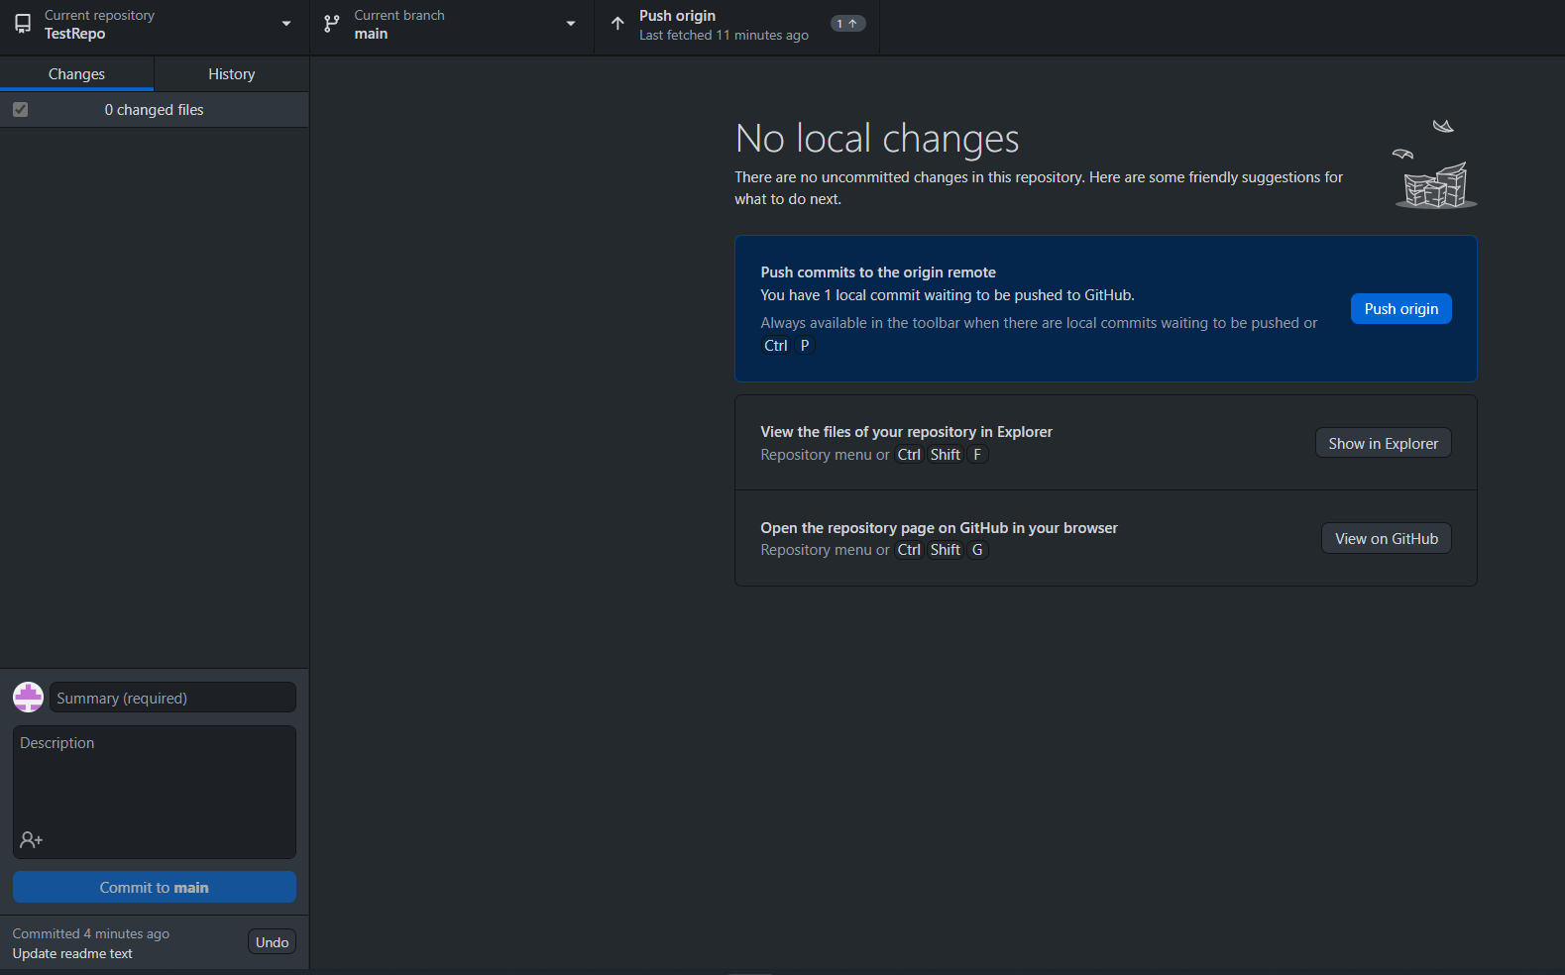
Github desktop – push
Notes:
Pushing is simple – just hit one of the two options to push origin which will push your commit

Slide 21
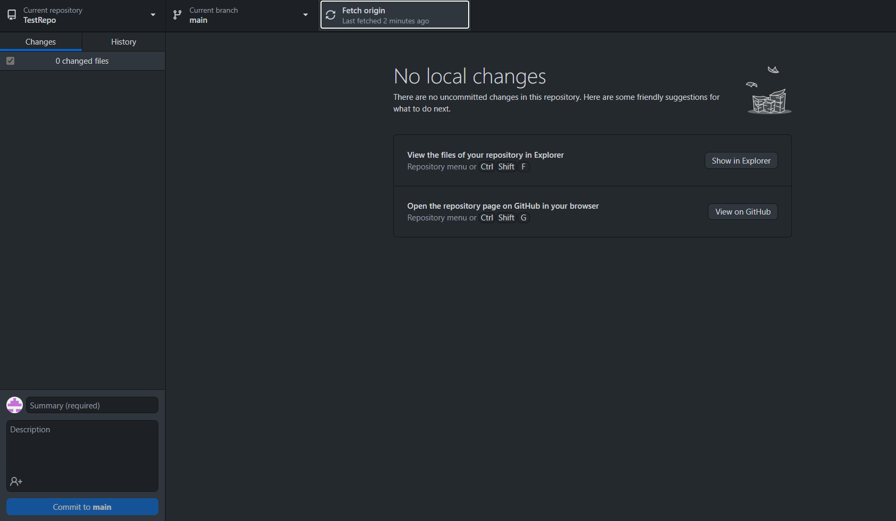
Github desktop - pull
Notes:
Pull is also simple – just hit fetch origin button

Slide 22
Putting existing projects into repositories
Might have started a project already without setting it up as a repository initially
Best way to move this to GitHub is to make a new empty repository in the language we are using for our project
Clone this repository to our local machine
Move the files to the new local folder
Push the changes the GitHub with our existing project files

Slide 23
General tips
Commit any changes you have made at end of each day, ideally more frequently
If doing a public facing project make sure data being used in analysis is linked in your code
Use GitHub for personal projects as much as possible to build your skills and understanding
Explore GitHub for topics you’re interested in, there are lots of cool resources available for many topics

Slide 24
Hackathon Information
The next NISR Hackathon will be taking place over the summer with the final boot camp being held in early September
We are still deciding what the topic and competition will be
Entries will be allowed from current university undergraduate and masters students
Knowing how to use GitHub will be part of the competition

Slide 25
Future webinars
As part of both the hackathon and NISR outreach we are planning to have another 2 webinars before first submissions for the hackathon
Potential ideas for these include:
How to deliver and design a presentation
How to build your own website using GitHub pages
Introduction to data visualisation
Please in the comments or otherwise suggest any other things you would want to learn about

Slide 26
Additional Resources
https://www.slideshare.net/bcbbslides/introduction-to-git-and-github-72514916 - general introduction to git and github
https://www.zdnet.com/article/how-to-get-started-with-git-on-linux/ - getting started with git on linux
https://phoenixnap.com/kb/install-git-on-mac - getting started with git on mac
https://happygitwithr.com/index.html - guide on GitHub integration with RStudio
https://blog.reviewnb.com/jupyterlab-git-extension/ - guide on using GitHub integration with JupyterLab

Slide 27
Any questions?
Questions will also be accepted at jack.duncan@nisr.gov.rw if you see this after it has been initially broadcast.

